Slide 1

Olist Sales & Revenue Insights
Strategic Growth & Operational Efficiency

Slide 2

The goal of Analysis
1- Understand Revenue Factors
2-Clients Satisfaction
3-Improve Seasonal Planning

Slide 3
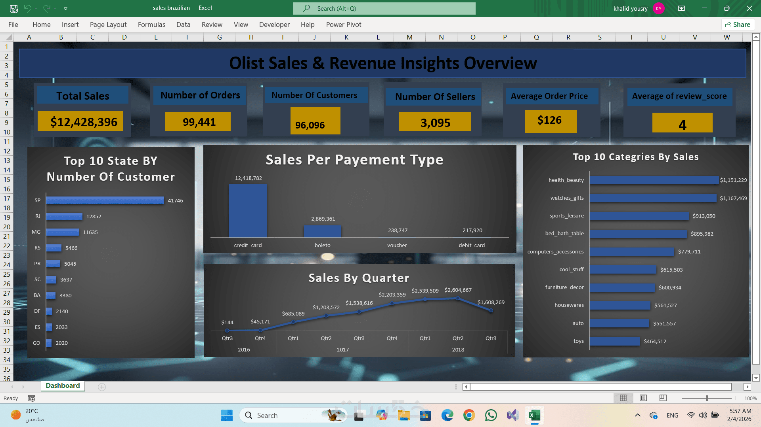
Executive Summary

Slide 4
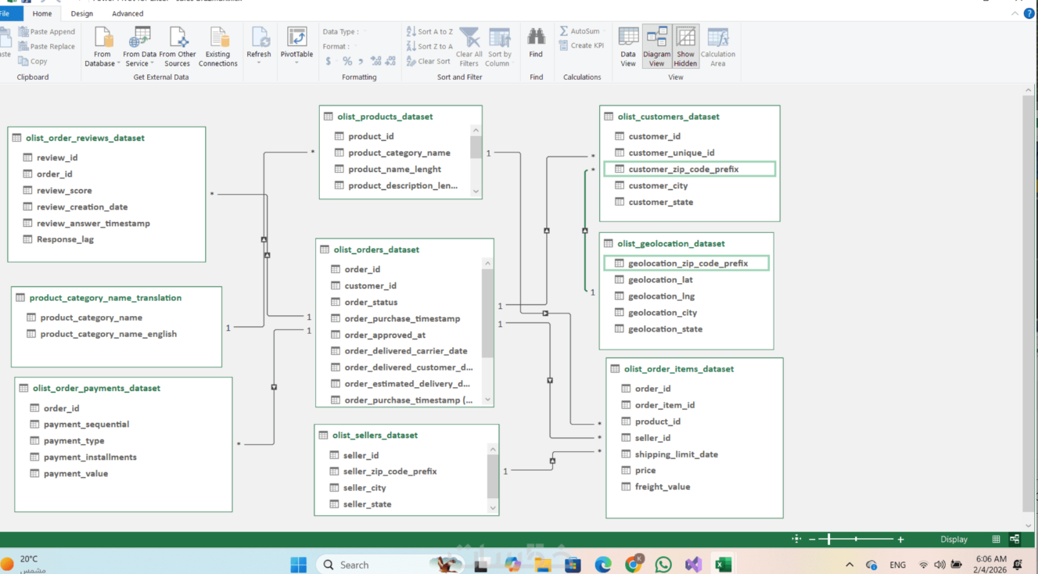
Robust Data Foundation for Accurate Insights"
.

Slide 5

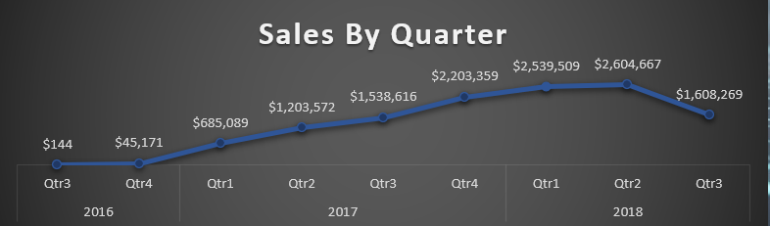
Peak Season Problem
Sales growth reveals a predictable but extreme seasonal pattern, with Q4 creating significant operational pressure.

Slide 6

Strategic Solution: Demand Shifting
Pre-Season Early Bird Campaign
Launch exclusive discounts and promotions one month before peak season to incentivise early purchases and smooth demand distribution.
Operational Benefits
Reduce Q4 logistics pressure by 30-40%
Avoid emergency overtime costs
Improve order fulfillment accuracy
Enhance customer experience with faster delivery

Slide 7
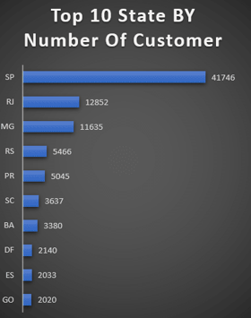
Geographic Goldmines
São Paulo Dominance
São Paulo (SP) leads as the top-performing state, representing the largest customer base and highest revenue contribution. This established market presents significant opportunities for targeted investment.
Strategic Opportunity
Invest in hyper-localised marketing campaigns, regional partnerships, and expanded logistics infrastructure to capitalise on existing market strength and capture additional market share.

Slide 8
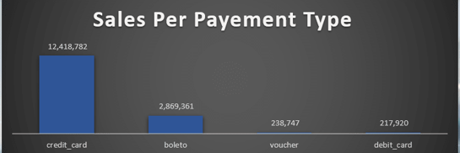
Premium Peak Pricing Strategy
Dynamic Pricing Model
Implement time-based pricing adjustments during peak days to maximise revenue whilst managing demand intensity.
Shipping Fee Optimisation
Introduce premium shipping tiers during high-demand periods, filtering for high-intent customers willing to pay for guaranteed delivery.
ROI Impact
Strategic pricing during 15-20 peak days can generate incremental revenue of $800K-$1.2M whilst improving service quality for all customers.

Slide 9
Thank you
Khalid Yousry

